Slide 1


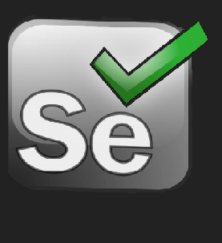
Protractor
Selenium

